Slide 1


UF CES-GMF
Student Travel and Trilogue
Renewing the Transatlantic Relationship for the Future

Slide 2
Info Session Overview
  Introduction
  Background
    German Marshall Fund Program
    Why European Security?
  Student Travel Competition
    Overview
    Eligibility & Requirements
    Schedule
    Application Process
  Q&A

Slide 3
Introduction

Slide 4
Who we are
Sandra Bartol
Co-Project Leader
Kristijan Ležaić
Co-Project Leader
Amie Kreppel
Director, UF Center for European Studies
Professor, Department of Political Science
Corinne Tomasi
Academic Programs Coordinator, UF Center for European Studies

Slide 5
Background

Slide 6
German Marshall Fund Program
Renewing the Transatlantic Relationship for the Future
Grant that aims to promote young Americans’ understanding of the EU and its structure, values, and policies
Grants are based on one of 7 themes:
  Trade, investment, economy
  Data privacy and digitalization
  Fundamental rights and immigration
  Security and defense
  Learning and skills for digital economy
  Tackling climate crisis through sustainable urban transportation
  Combatting organized crime and terrorism
Activities for students include competitions, convenings, and study visits to the EU

Slide 7
CES-GMF Program
Organized and led by Sandra Bartol and Kristijan Ležaić in collaboration with UF Center for European Studies
Awarded a Renewing Transatlantic Relations grant for Spring 2023.
  Focus on security and defense
Two parts of the project:
  Student Travel
  Negotiation Simulation

Slide 8

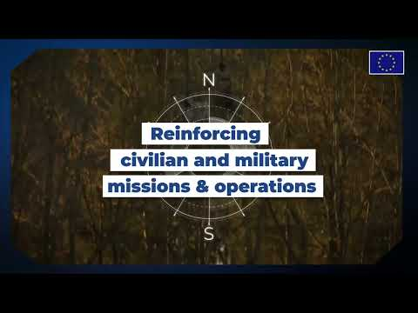
Why a Strategic Compass?

Slide 9
Why a Strategic Compass?
Strategic Compass formally approved by EU member states in spring 2022
  Plan of action to strengthen EU security and defense policy by 2030
Objective is to make the EU a stronger and more capable security provider based on 4 pillars:
  Act
    Rapid deployment capacity
    Live exercises
    More flexible decision-making process
    European Peace Facility
  Secure
    Boost intelligence analysis capacity
    Hybrid toolbox
    Cyber defense
    EU Space Strategy
  Invest
    Enhance member state defense expenditures
    Technological innovation
    Next generation capabilities
  Partner
    NATO, UN, regional partners
    Bilateral partnerships

Slide 10
Student Travel Competition

Slide 11
Overview
  3 students
      Open to UF students from all majors and colleges
  1-week travel to Sweden and Belgium
  Travel Dates:
      Sunday, May 7 – Sunday, May 14, 2023
  Fully Funded
        GMF and CES will cover the cost of flights, accommodation, transportation to/from airport(s) in Europe
        NOT covered – student international health insurance; meals*; luggage fees*; transportation to/from the airport in US
  Students are accompanied by UF official

Slide 12
Eligibility & Requirements
Eligibility
  Participants must be active UF students at time of program (e.g. cannot be graduating spring 2023)
  US citizen or permanent resident
  Must hold valid passport (valid 6 months after return)
Requirements
  Attend pre-departure meeting
  Provide proof of valid passport
  Participate in negotiation simulation

Slide 13


Schedule of Travel (tentative)
Sunday, May 7: Depart FL
Monday, May 8 – Tuesday, May 9: Brussels, Belgium
  Tentative meetings may include:
    NATO Parliamentary Assembly
    House of European History
    EU Parlamentarium
Tuesday, May 9 – Wednesday, May 10: Stockholm, Sweden
  Tentative meetings include:
    Ministry of Defense
    Ministry of Foreign Affairs
Thursday, May 11 – Saturday, May 13: Brussels, Belgium
  Tentative meetings may include:
    Swedish Presidency
    EU Institutions (possibly – Commission, Parliament, European Council)
    US Embassy to the EU
Sunday, May 14: Return to FL

Slide 14
Application Process
(by
Award Application Form
Statement of Purpose
3-4 pages (750-1250 words) that must include the following:
  Introduction – tell us about you (e.g. major(s), minor(s), year, interests, etc.)
  What are your academic and career interests and how would the GMF trip and negotiation simulation help you toward those interests?
  The Swedish Presidency of the Council of the EU has identified security and implementation of the EU Strategic Compass as a top priority for its six-month tenure Identify 2 objectives from the SC that will be instrumental for the transatlantic security relationship and that relates to your academic or career interests.
    Student should be specific in their responses, indicating the specific basket and objective addressed
    The Stategic Compass is a comprehensive plan that touches upon many facets of policy beyond traditional political science or security
  Any additional information you would like the share with the review committee.
Unofficial UF Transcript
Deadline to apply: Friday, March 3, 2023 (by 5:00 pm ET)

Slide 15
Negotiation Simulation

Slide 16
The Negotiation
Students on the trip will participate in a negotiation between the EU, US, and Sweden.
The topic will be related to the situation in Ukraine.
Students will each represent the interests of one of the three negotiation actors with the
Aim of finalizing a joint statement for a new trilateral agreement.

Slide 17
What does the simulation look like?
Half-day simulation in Brussels
Prompt will be provided in advance of the trip
Students expected to conduct external research to prepare
Meetings in Brussels and Stockholm intended to help solidify position and negotiation strategy
  Students should have done research in advance to get the most from the institutional visits.

Slide 18
Thank you for your time!
Questions?
Contact Details:
Corinne Tomasi – corie@ufl.edu

